Slide 1
NYC Parking Ticket

Slide 2
Dataset
Our dataset contains 4 .csv files, 42.3 million rows of parking ticket data from Aug, 2013 to June, 2017
It can be get from https://www.kaggle.com/new-york-city/nyc-parking-tickets/
Or use our filemail link: https://fil.email/tEeuxVK7
(expires on 16th, Dec)

Slide 3
Questions
Do some specific street have more violation?
Do violations happen more in specific time period of a dat?
Are their certain brand or vehicle type more likely to violate?
Which state’s vehicle are more likely to violate?

Slide 4
Parallel Computation
For the dataset is huge, but what we what to do is not complicated, so we chose to use CHTC to conduct computation.

Slide 5
Parallel Computation
Split data
Merge all the results
Visualization
Computated separately

Slide 6
Results

Slide 7
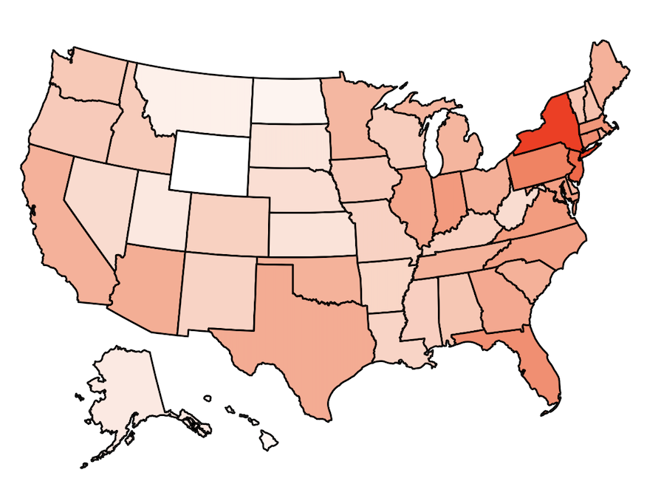
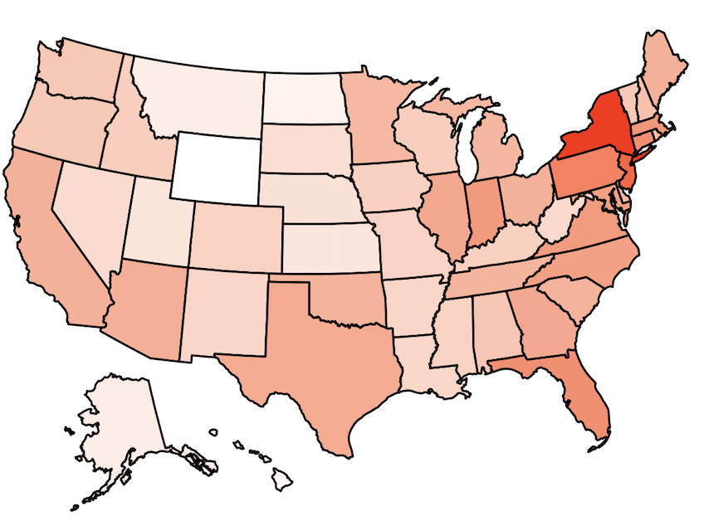
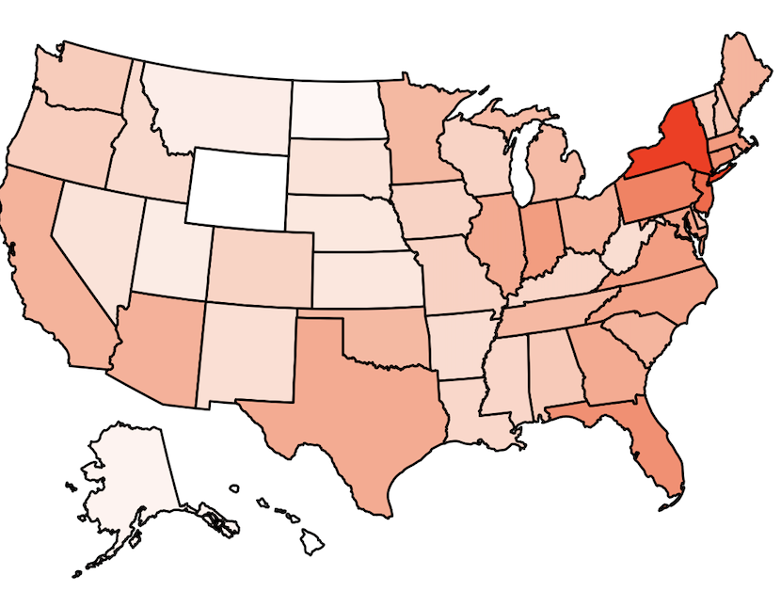
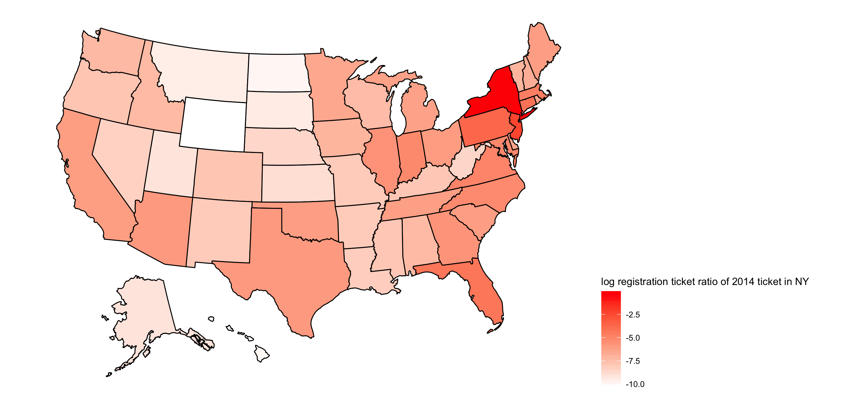
2015 2016 2017
Ratio of Ticket Vehicle Registration States
NY: 77.7%
NJ: 9.7%
PA: 2.5%
……
WY: 0.00003
2014

Slide 8
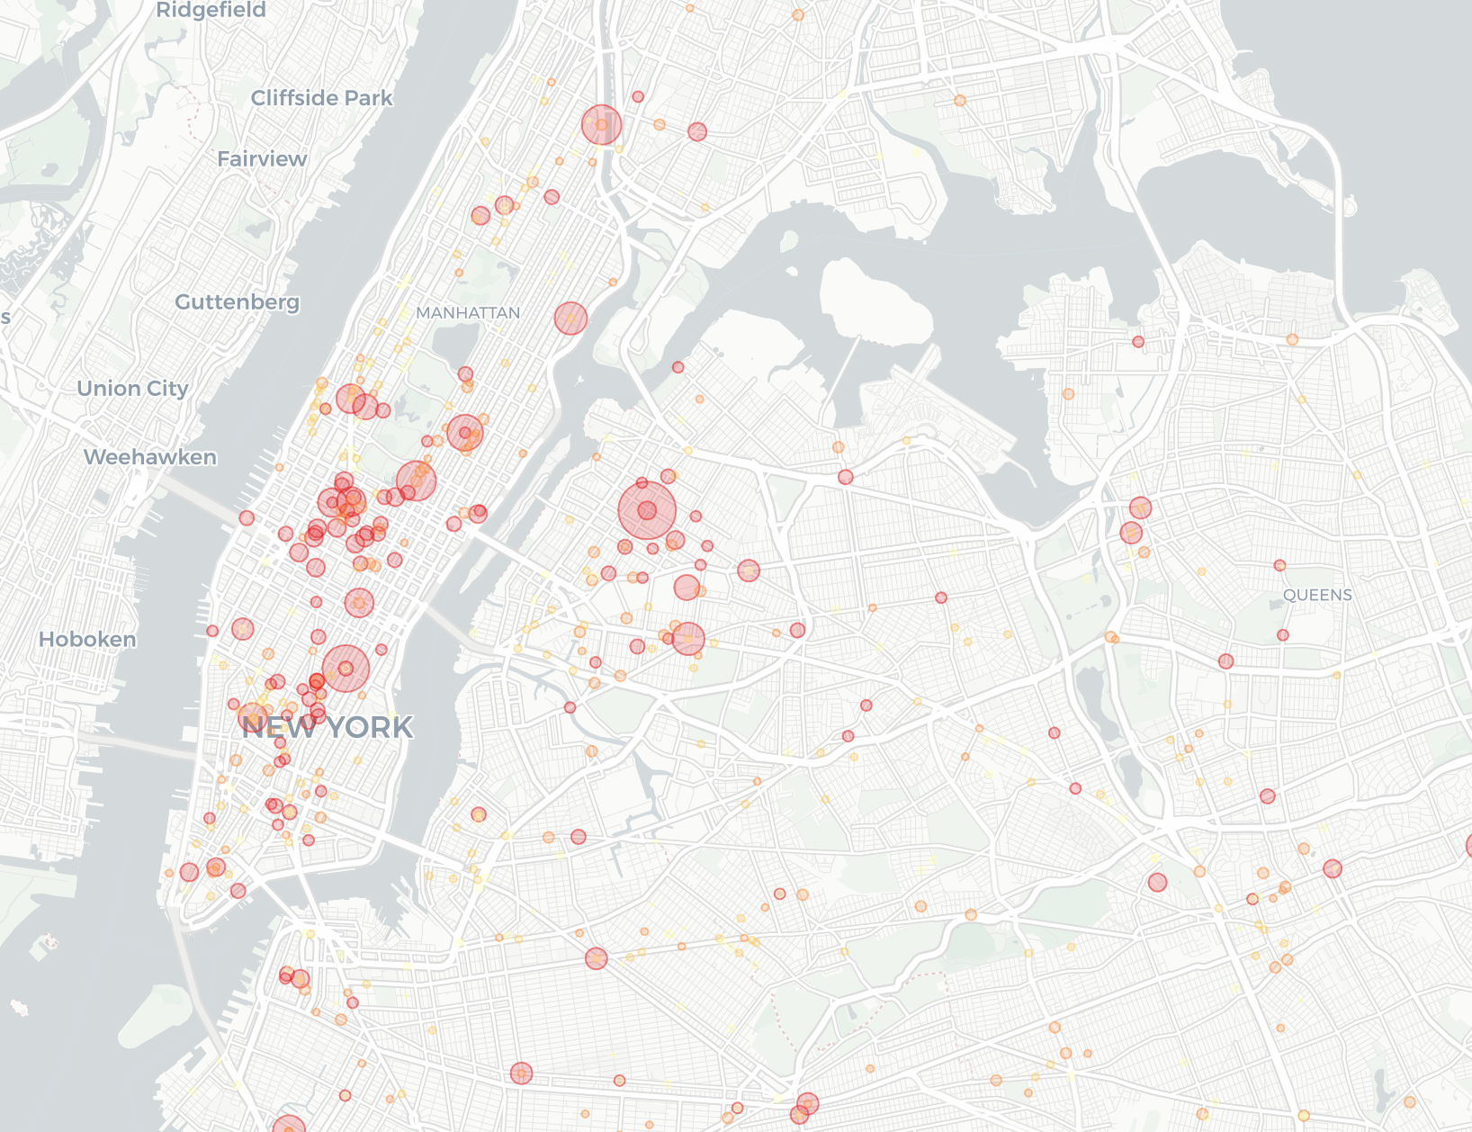
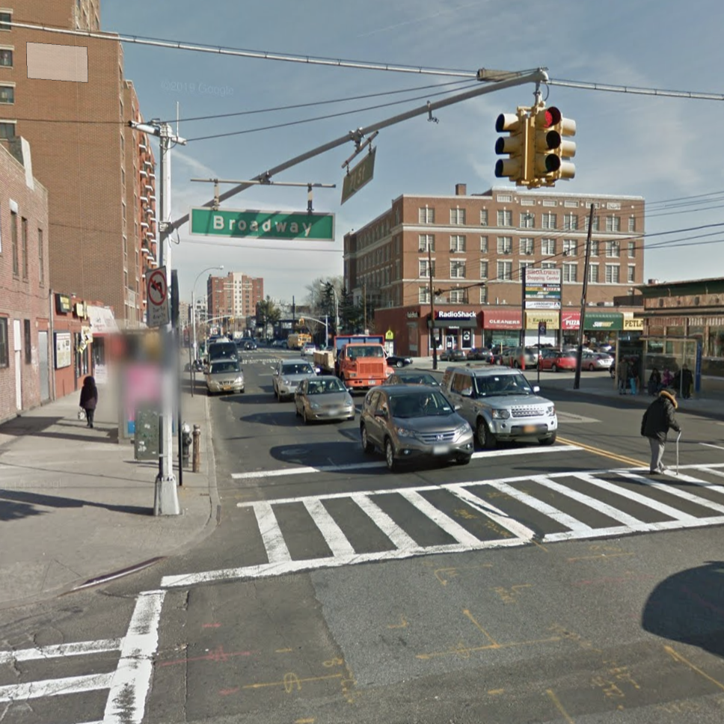
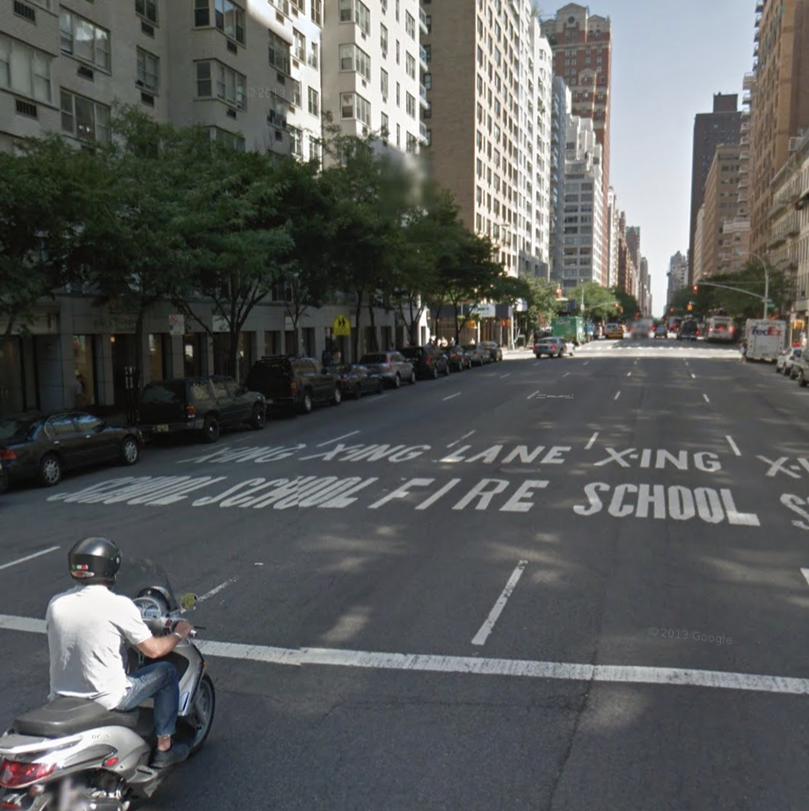
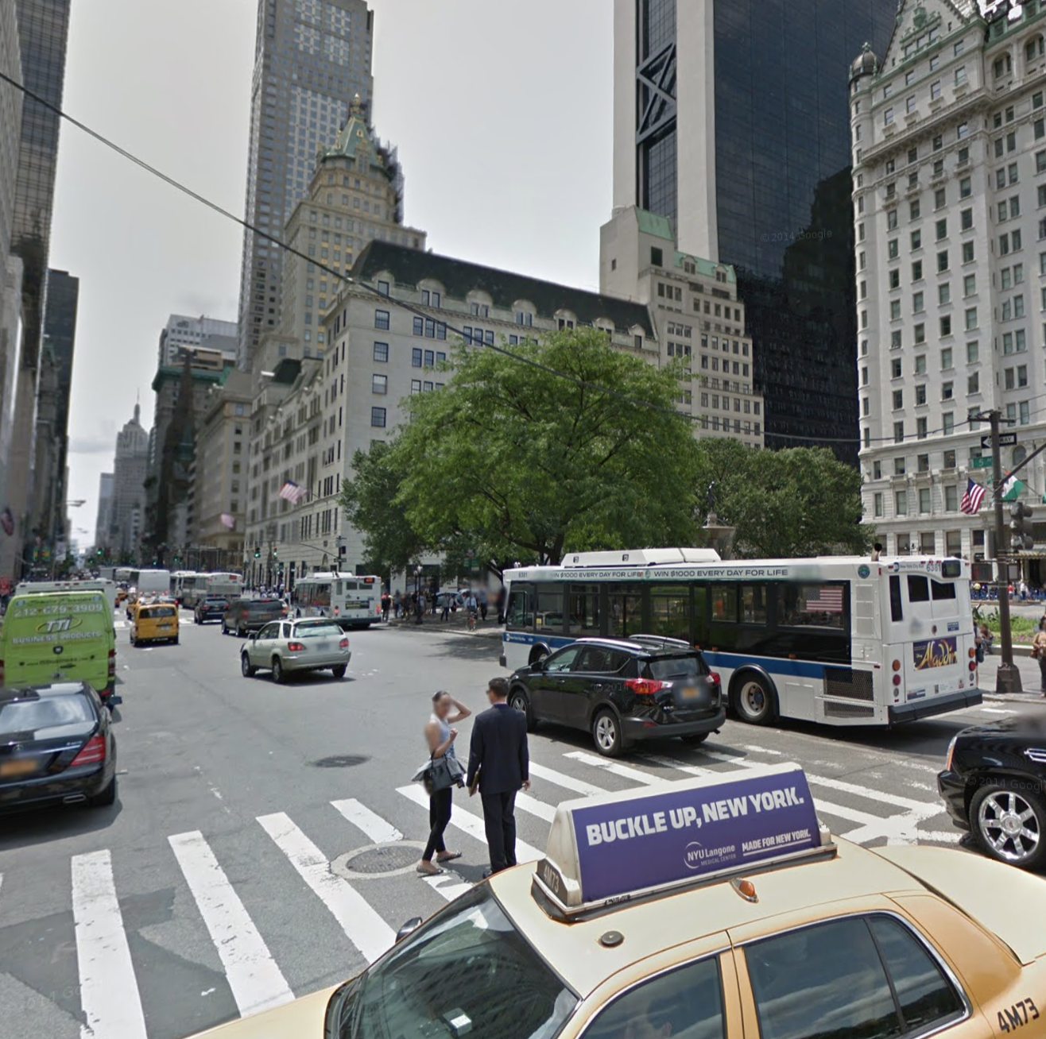
2014 Ticket Location Visualization
Top 1: Broadway
201980
Top 2: 3rd AVE
148186
Top 3: 5th AVE
97622

Slide 9
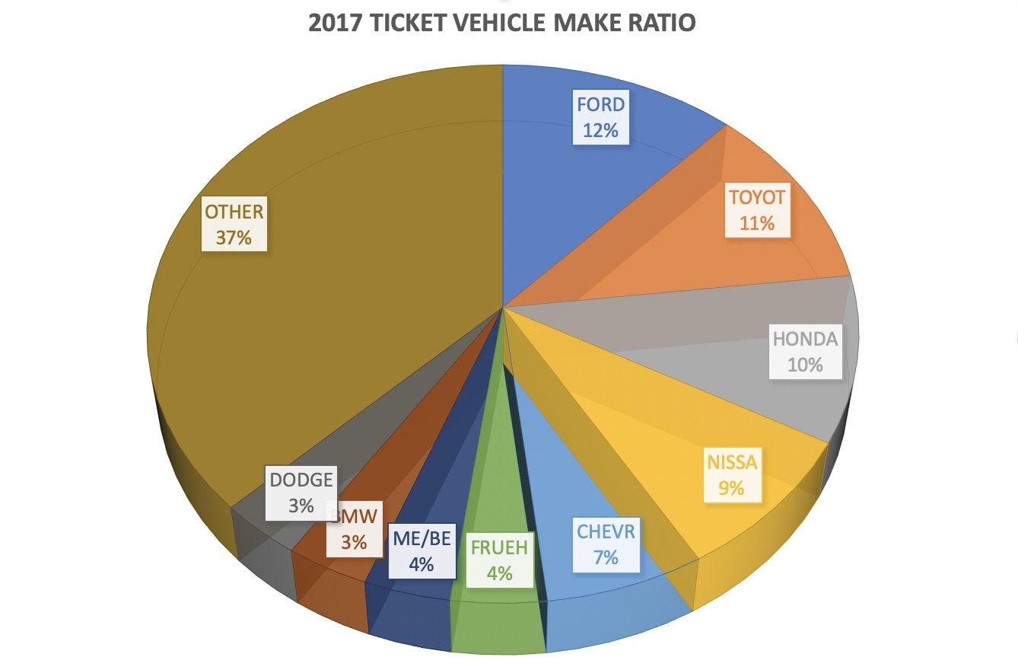

2017 Ticket Vehicle Brand Ratio
12%
11%
10%

Slide 10
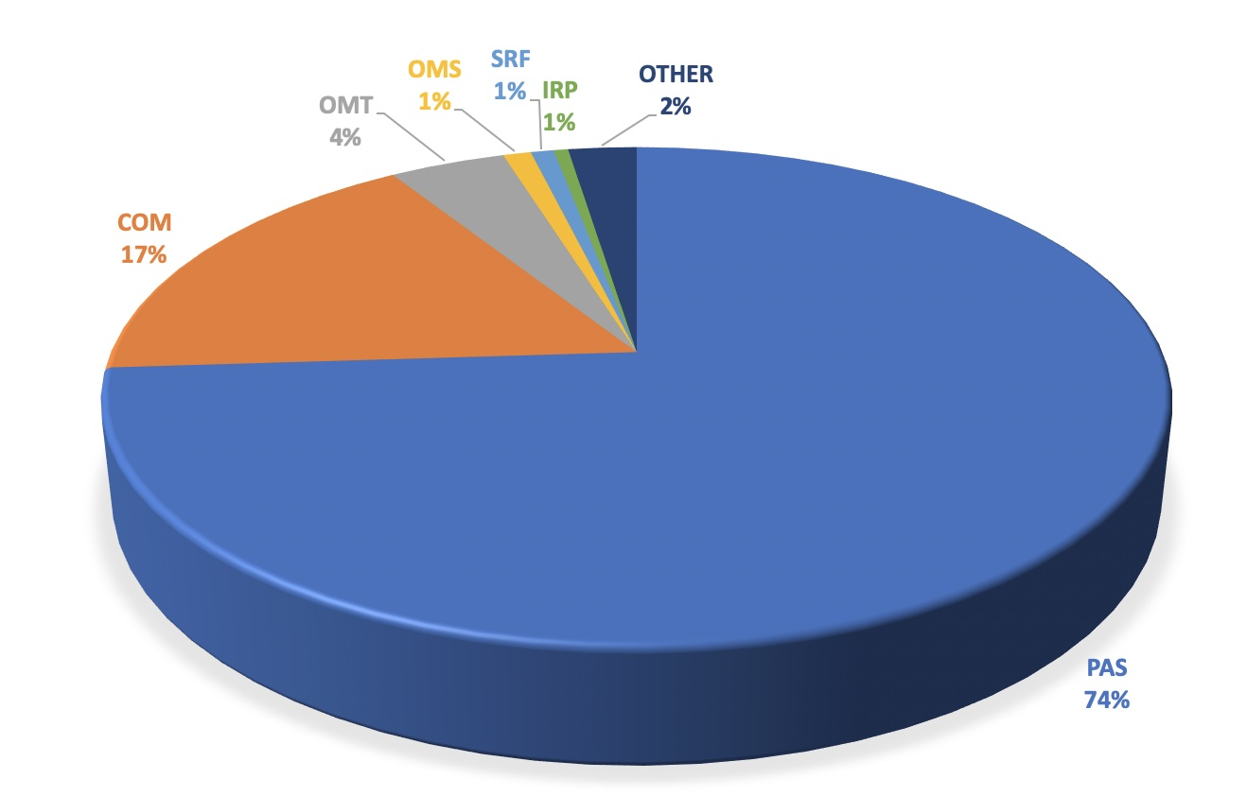
2017 Ticket Vehicle Type Ratio
74%: PAS, Passenger Vehicles
17%: COM, Commercial Vehicles
4%: OMT, Medallion

Slide 11
